Slide 1

Air Quality Index Prediction
by
K.Bhaskar
Roll No. 194G5A0501
R.Bhargavi
Roll No. 184G1A0505
S.Khathi Jatul Kubra
Roll No. 184G1A0525
T.N.Bhavitha
Roll No. 184G1A0506
Under the guidance of
Mr. K.Venkatesh M.Tech.
Assistant Professor
Department of Computer Science and Engineering
Srinivasa Ramanujan Institute of Technology
(Affiliated to JNTUA & Approved by AICTE) (Accredited by NAAC with ‘A’ Grade & Accredited by NBA (EEE, ECE & CSE)
Rotarypuram Village, B K Samudram Mandal, Ananthapuramu – 515701.
2021 - 2022

Slide 2
Abstract
Day by day the air pollution becomes serious concern in India as well as in overall world. Proper or accurate prediction of Air Quality or the concentration level of other Ambient air pollutants such as Sulfur Dioxide, Nitrogen Dioxide, Particulate Matter etc. is very important because impact of these factors on human health becomes severe.
Air quality index is a standard measure used to indicate the pollutant (so2, no2, rspm, spm. etc.) levels over a period. We developed a model to predict the air quality index based on historical data of previous years. Our model will be capable for successfully predicting the air quality index of a total country provided with the historical data of pollutant concentration.

Slide 3
Review 0 Remarks
Which algorithms are used?
What is trained data set ?
Explain Linear Regression ?

Slide 4
Review_1 Remarks
1. What are the Attributes ?
2. How many features are present in the dataset ?
3. What is scope of your project ?

Slide 5

Contents
Introduction
Existing System
Proposed System
Literature Survey
Problem Definition
Planning
Requirements
Design
Implementation
Conclusion
References

Slide 6
Introduction
The sharp rise in air pollution in recent years, due to industrial and agricultural activities, as well as increased number of vehicles using internal combustion engines, has caught the attention of the scientific community. Air pollution has significant impact on human health and may cause long-term health issues in children. The significant rise in air pollution in India is attributed to increased vehicular emissions, burning of fossil fuels at power plants, and other local industries and burning of fields by farmers.

Slide 7
Contd..
As the largest growing industrial nation, India is producing record amount of harmful aerial contaminants. Air quality of a particular state or a country is a measure on the effect of pollutants on the respected regions, as per the Indian air quality standard pollutants are indexed in terms of their scale, these air quality indexes indicates the levels of major pollutants on the atmosphere.
There are various atmospheric gases which causes pollution on our environment. Each pollution has individual index at different levels. The major pollutants Such as (no2, so2, rspm, spm) indexes AQI is acquired, with this individual AQI, the data can be categorized based on the limits.

Slide 8
Existing System
Air pollution is a major concern these days. The presence of an unwanted thing, contaminant, or agent in the air leads to air pollution.
Air Quality Index is a number used to convey the quality of air. Air quality deteriorates with an increase in the concentration of pollutants.
Earlier classical methods such as probability, statistics were used to predict the quality of air, but those methods are very complex to predict the quality of air and time consuming.

Slide 9
Proposed System
Due to advancement of technology, now it is very easy to fetch the data about the pollutants of air using sensors.
The Air pollutants information is retrieved from the sensors which are processed in a unified schema and stored as a dataset. This dataset is preprocessed .Once the dataset is ready, it is split into training dataset and test dataset. And further Supervised Machine Learning Algorithms are applied on the training dataset. The obtained results are matched with the testing dataset and results are analyzed

Slide 10
Literature Survey
[1] In this paper, Logistic regression is employed to detect whether a data sample is either polluted or not polluted. Autoregression is employed to predict future values of PM2.5 based on the previous PM2.5 readings. Different machine learning models have been applied to detect air pollution and predict PM2.5 levels based on a data set consisting of daily atmospheric conditions.
[2] In this paper the aim is to investigate machine learning based techniques for air quality prediction. The air quality dataset is preprocessed with respect to univariate analysis, bi-variate and multi-variate analysis, missing value treatments, data validation, data cleaning/preparing. Then, air quality is predicted using supervised machine learning techniques like Logistic Regression, K-Nearest Neighbors, Decision Tree and Support Vector Machines. The performance of various machine learning algorithms is compared with respect to Precision, Recall and F1 Score. It is found that Decision Tree algorithm works well for predicting air quality.

Slide 11
Contd..
[3] In this research paper they have predicted the air quality of India by using machine learning algorithms of a given area.They have developed a model to predict the air quality index based on historical data of previous years and predicting over a particular upcoming year as a Gradient decent boosted multivariable regression problem.
[4] This literature review focuses on the various techniques used for prediction or modelling of Air Quality Index (AQI) and forecasting of future concentration levels of pollutants that may cause the air pollution so that governing bodies can take the actions to reduce the pollution. The purpose of this literature review paper is to know in detail about the Air Quality Index (AQI) as AQI tells whether the air around us is polluted or not. Linear and Logistic Regression algorithms are used[4]

Slide 12
[5] In this Paper Huixiang Liu (et al.2019) have taken two different cities Beijing and Italian city for the study purpose. They have forecasted the Air Quality Index (AQI) for the city Beijing and predicting the concentration of NOxin an Italian City depending on two different publicly available datasets. They used Support Vector Regression (SVR) and Random Forest Regression (RFR) techniques for AQI and NOx concentration prediction. SVR shows better performance in prediction of AQI while RFR gives the better performance in predicting the NOx concentration.

Slide 13
Problem Definition
Urbanization is one of the main reasons for air pollution because, increase in the transportation facilities emits more pollutants into the atmosphere and another main reason for air pollution is Industrialization. The major pollutants are Nitrogen Oxide (NO), Particulate matter (PM), SO2 etc. Measures must be taken to minimize air pollution in the environment. Air Quality Index is used to measure the quality of air.
The overall objective of our work is to predict the accuracy with few tests and attributes in predicting the air quality. Attributes considered from the primary basis for tests and give accurate results.
The predicted results can be used to predict the air as ‘Good’, ‘Moderate’ , ‘Poor’ and ‘unhealthy’.

Slide 14
Requirements :
Hardware Requirements:
Processor : i3/Intel Processor
RAM :8GB
Hard Disk :128GB
Software Requirements:
Operating System :Windows 7+
Server Side Script :Python 3.8
IDE :Jupyter Notebook
Libraries used :Numpy, Pandas, sklearn,seaborn

Slide 15
Design
Activity Diagram :
Dataset
Data Preprocessing
If contains Uncleaned data
Yes
No
Perform The Data Splitting into Training and Testing
Training the model
Applying the ML Algorithms
Finding Accuracy
Predicting using Trained Model

Slide 16
Architecture
Data Collection
Data
Pre-processing & Cleaning
Processed Data
Result Analysis
Test the model On Training Dataset
Training Model by applying machine learning algorithms

Slide 17
Implementation :
Training: Our training data consists with some features describing the pollutants present in air. We are given with pollutant concentration. The training data is what we will use to “teach” our models.
Testing: The test data set consists of some examples with the same number of features as the training data. Once our models have been built we will run the best one to test the data.
Tools:
We can use Python and Jupyter notebook for the Implementation. Jupyter notebooks are popular among data scientist and Machine Learning because they are easy to follow and show the working steps.

Slide 18
Contd..
Libraries: These are frameworks in python to handle commonly required tasks.The Libraries used are :
NumPy :
NumPy, which stands for Numerical Python, is a library consisting of multidimensional array objects and a collection of routines for processing those arrays. Using NumPy, mathematical and logical operations on arrays can be performed.
Scikit Learn:
The sklearn library contains a lot of efficient tools for machine learning and statistical modeling including classification, regression, clustering and dimensionality reduction.

Slide 19
Contd..
Pandas :
Pandas is an open-source Python package that is most widely used for data science/data analysis and machine learning tasks. It is built on top of another package named Numpy, which provides support for multi-dimensional arrays.
Seaborn:
Seaborn is a library for making statistical graphics in Python.Seaborn helps you explore and understand your data.

Slide 20
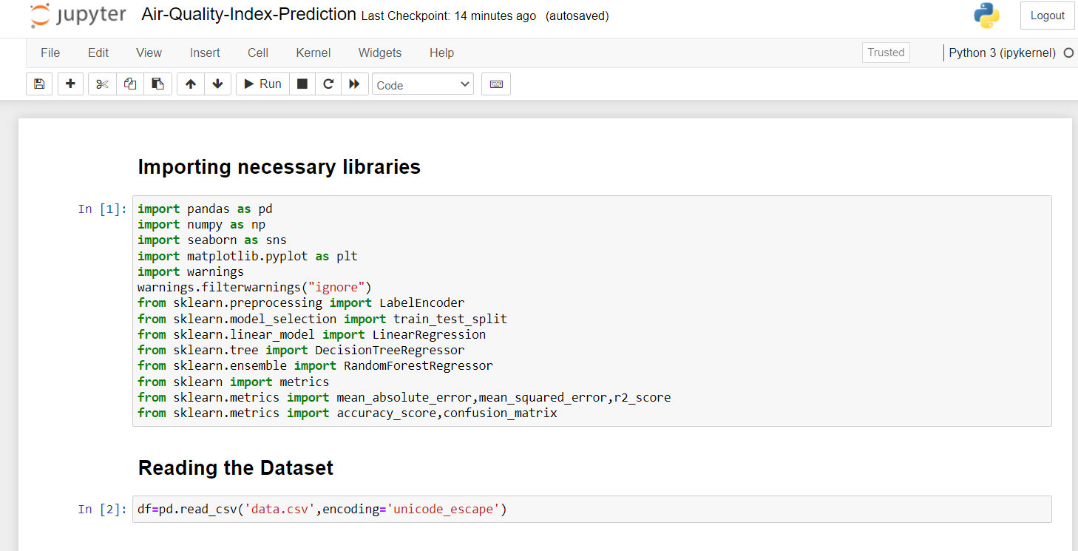
Sample Code

Slide 21
Review 2 Remarks
Why UML Diagrams are used in a project ?
How Data in the dataset is cleaned ?
What is Data Preprocessing ?
Explain about Data Cleaning Techniques?

Slide 22
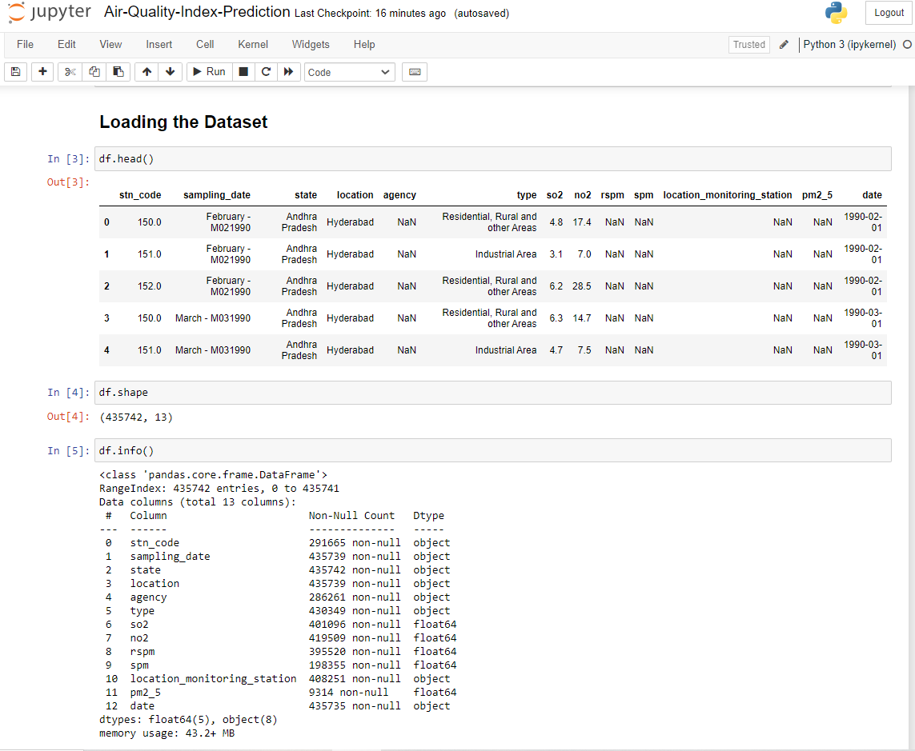
Contd..

Slide 23
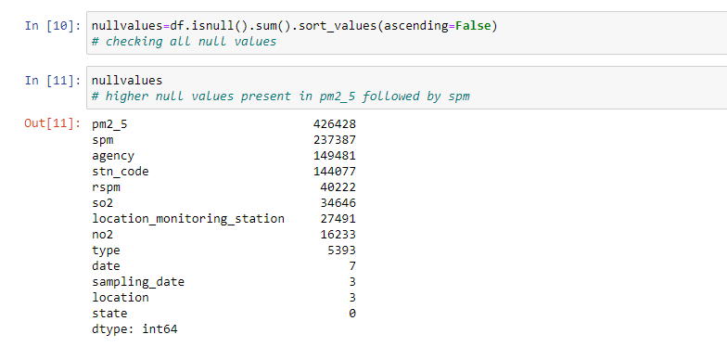
Contd..
Missing Values Present in the Dataset

Slide 24
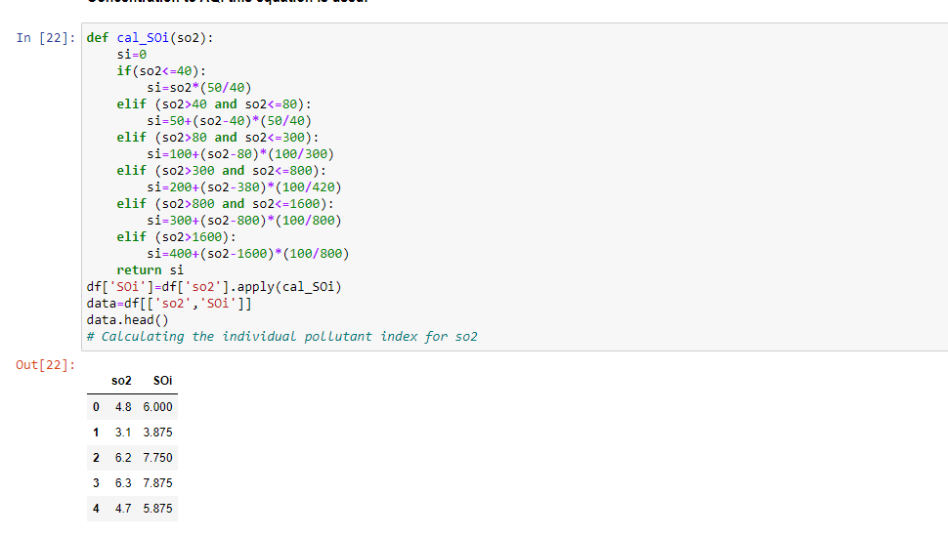
Contd..
Calculate Air Quality index for so2 individual pollutant index(soi)

Slide 25
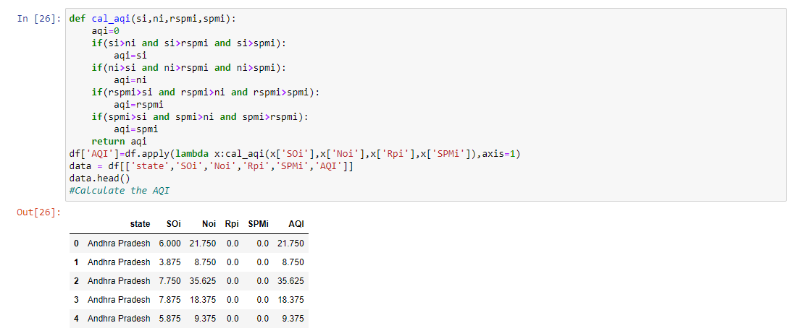
Contd..
calculate the air quality index of every data value

Slide 26
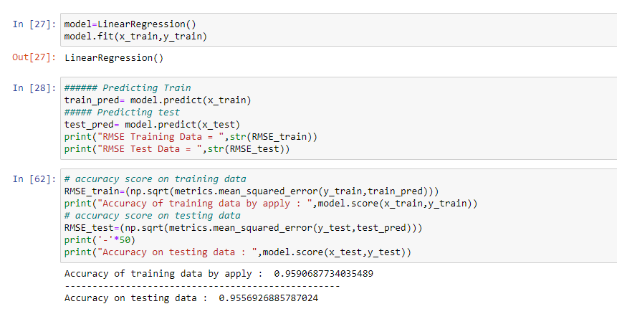
Training the model
Train and Test split of data
Fitting model with Linear regression.

Slide 27
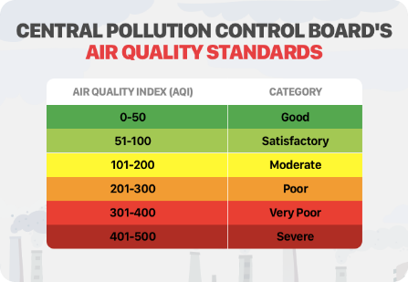
Contd..

Slide 28
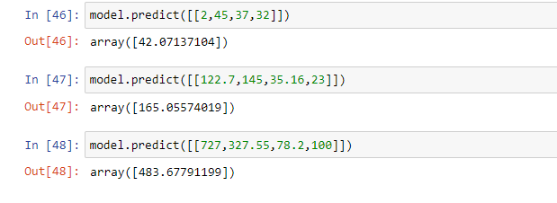
Predictions
Prediction of output using Linear Regression

Slide 29

Results
Score method of Linear Regression

Slide 30
Conclusion
The concentration of air pollutants in ambient air is governed by the parameters such as no2, so2, rspm, spm. Air Quality Index (AQI) is used to measure the quality of air. The proposed work is a supervised learning approach using different algorithms such as Linear Regression .
By performing the analysis using the algorithm Linear Regression provided the high accuracy for the trained model and predicts the Air Quality more accurately.

Slide 31
References
Data Set Url : https://www.kaggle.com/datasets/rohanrao/air-quality-data-in-india
Journals :
[1] Aditya C, Chandana R Deshmukh, Nayana D K, Praveen Gandhi Vidyavastu, “Detection and Prediction of Air Pollution using Machine Learning Models”, International Journal of Engineering Trends and Technology (IJETT) – ISSN: 2231–5381 volume 59 Issue 4- May 2018
[2] K. Mahesh Babu, J. Rene Beulah, “Air Quality prediction based on Machine Learning Methods”, International Journal of Innovative Technology and Exploring Engineering (IJITEE)ISSN: 2278- 3075, Volume-8, Issue-9S4, July 2019
[3] Pooja Bhalgat, Sejal Pitale, Sachin Bhoite, “Air Quality Prediction using Machine Learning Algorithms”, International Journal of Computer Applications Technology and Research Volume 8– Issue 09, 367-370, 2019, ISSN:-2319–8656

Slide 32
Contd..
[4] Radhika M.Patil, Dr. H. T. Dinde,Sonali. K. Powar, “A Literature Review on Prediction of Air Quality Index and Forecasting Ambient Air Pollutants using Machine Learning Algorithms”,International Journal of Innovative Science and Research Technology ISSN No:- 2456-216 Volume 5, Issue 8, August – 2020
[5] Huixiang Liu, Qing Li, Dongbing Yu, Yu Gu, “Air Quality Index and Air Pollutant Concentration Prediction Based on Machine Learning Algorithms”, Applied Sciences, ISSN 2076-3417; CODEN: ASPCC7, 2019, 9, 4069; doi:10.3390/app9194069.
World wide web:
[6] https://en.wikipedia.org/wiki/Air_quality_index
[7] https://pib.gov.in/newsite/printrelease.aspx?relid=110654
[8] https://machinelearningmastery.com/linear-regression-for-machine-learning/
[9] https://levelup.gitconnected.com/random-forest-regression-209c0f354c84

Slide 33
Thank You!!!

